Slide 1

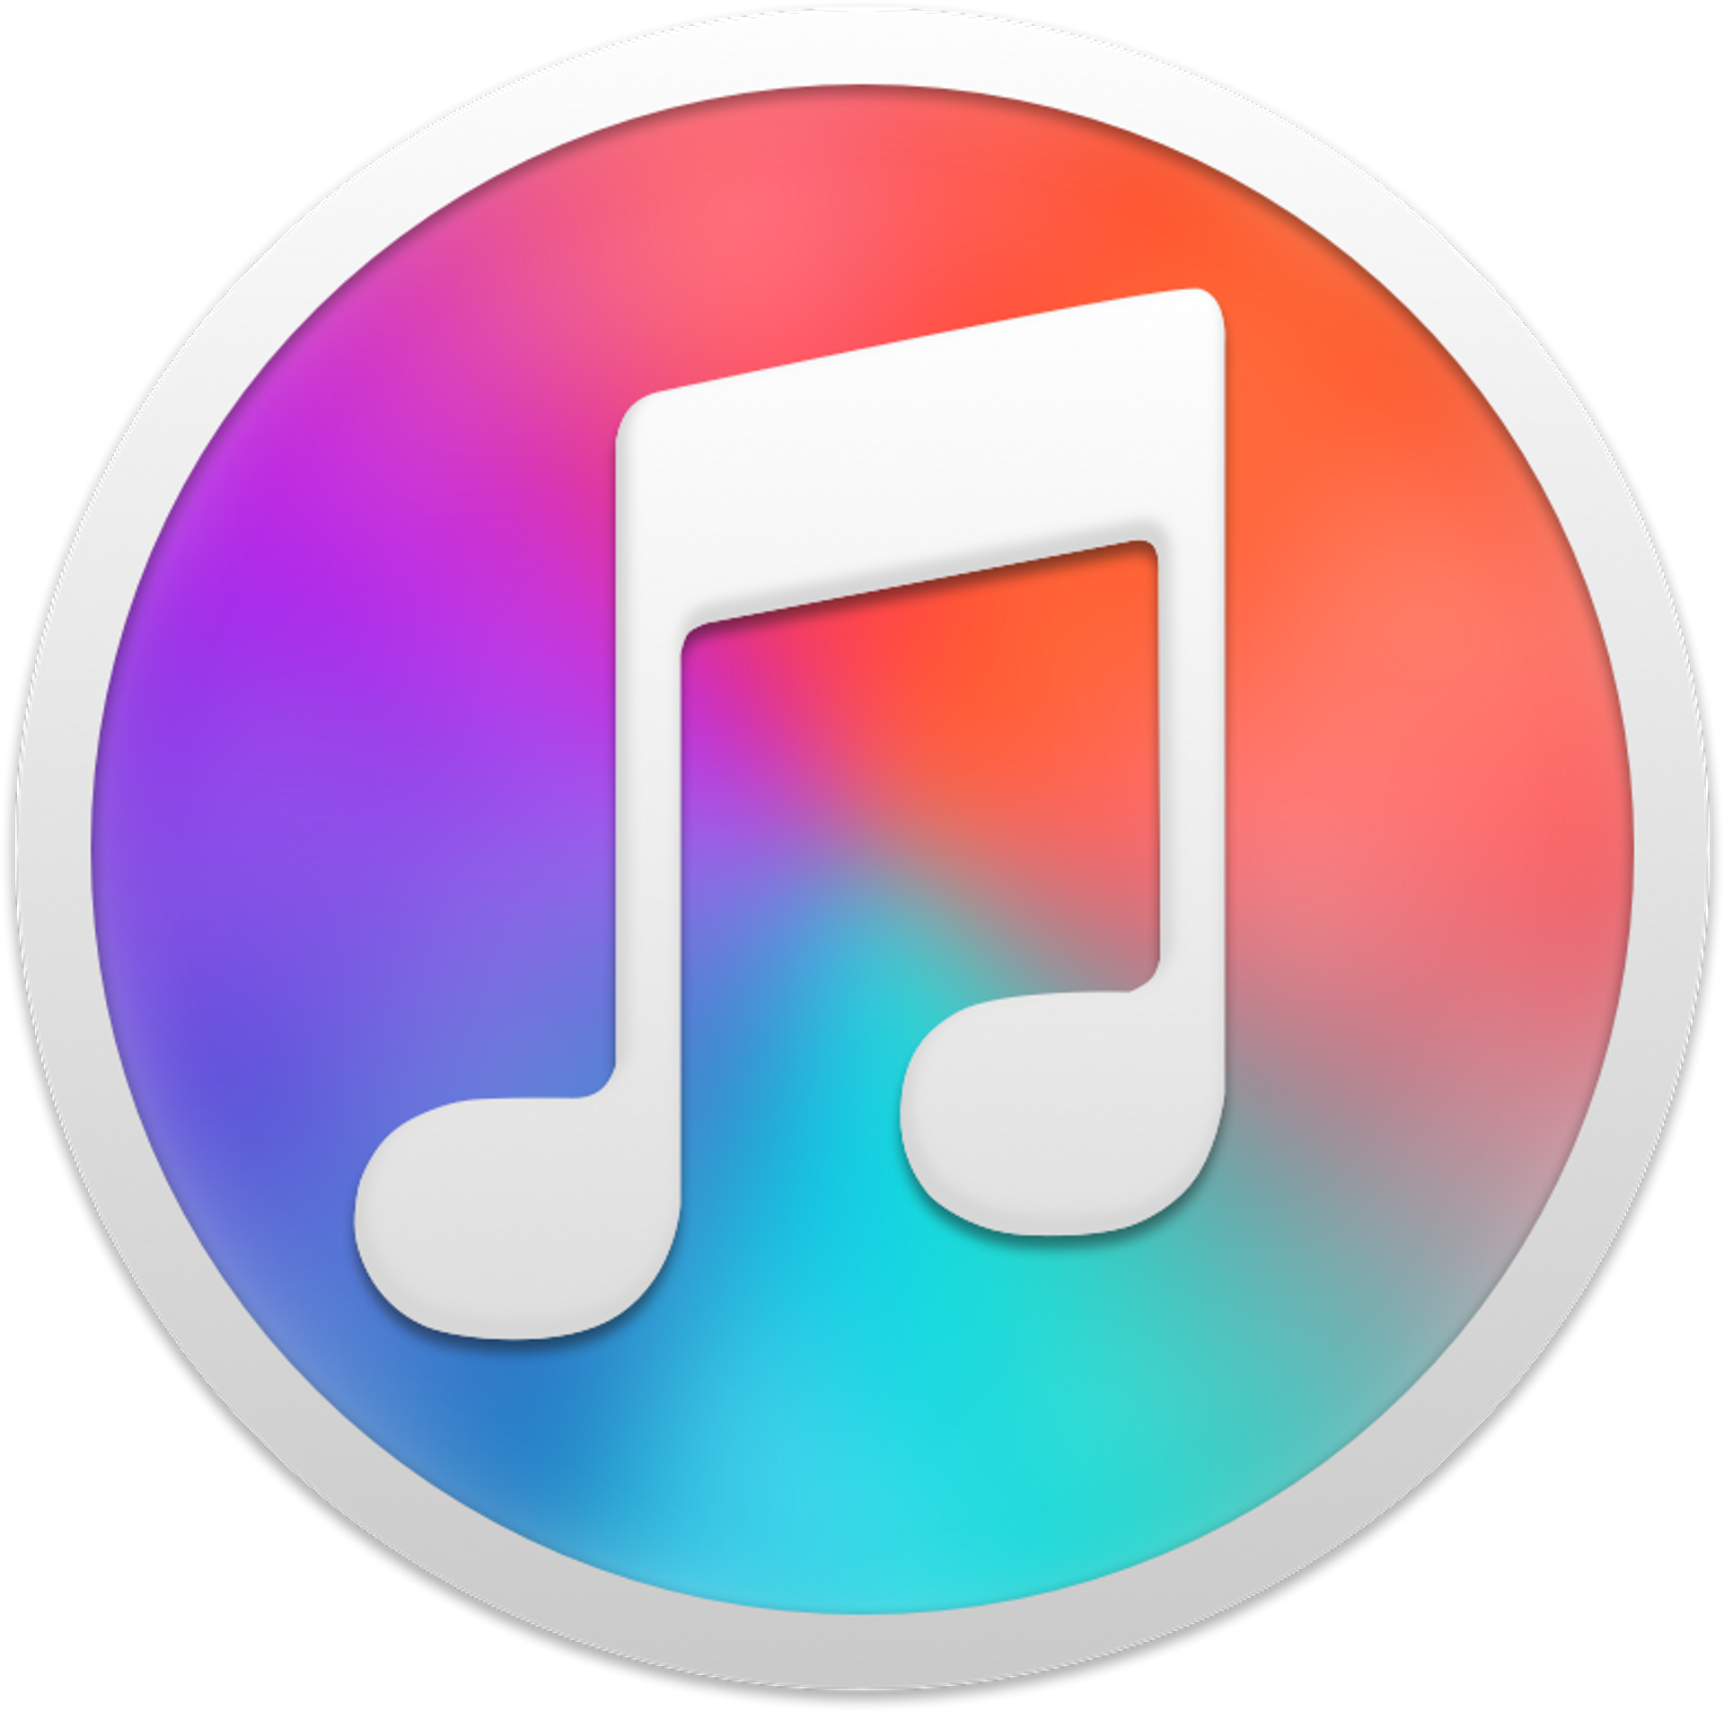
Music App
Listen And Sing

Slide 2

Inspirational quote
“Music has the power to heal, uplift, and transform lives.”
- Ravi Shankar

Slide 3

Introduction
As we venture into a new era of audio exploration, our app stands out as a testament to innovation and creativity in the realm of music applications.
A Innovative Music Application With New Features Such As KARAOKE MODE, COLLABORATIVE MUSIC, DJ OPTIONS, MODERN ANIMATIONS and Also with normal features such as streaming music, sharing music with world, creating custom playlists and much more.
But our app is more than just a collection of features. It's a community, a hub for music enthusiasts to explore, share, and create.

Slide 4

Key Features
Karaoke Mode: While in the KARAOKE mode, a user will have a peaceful experience with our user-friendly application and can enjoy singing along with the music.
Custom media: Users can upload their songs and will be able to access the files on the cloud. And the user will have rights to make their songs public or private.
Modern Animations: Experience music like never before with modern animations that breathe life into your playlists
Stream songs: Enjoy listening to music to anytime anywhere with ease and peacefully

Slide 5
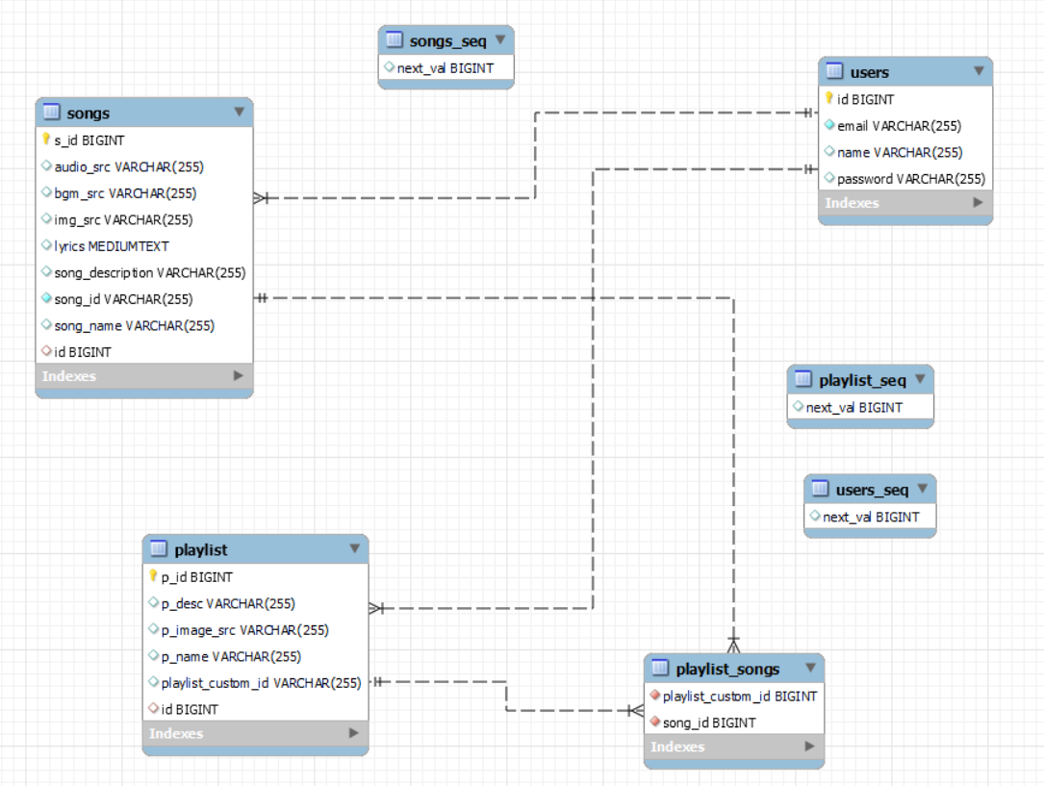
Database Entity-relationship(ER) diagram

Slide 6
Technologies used
Frontend : React.js, Tailwind CSS
Backend : Spring Boot
Database : MySql + Firebase
Project Management Tool : GitHub
Api Testing : ThunderClient/Postman

Slide 7
Future work
Collaborative Music: this enables users to synchronously connect with other users and simultaneously listen to song without any delay enabling users to host parties and use our app as a media provider.
DJ options: this enables users to customize their songs transition, playback, sounds and much more similar to a lightweight DJ

Slide 8
Project learning's
Spring Boot: we learnt how to create REST api’s in spring boot in MVC(Model View Controller) architecture and perform CRUD operations through various request mapping’s.
MySql: we learnt how to connect mysql database to spring boot application and perform CRUD operations on mysql database.
React.js: we learnt the best practices and pitholes while developing react app. We made use of almost all the features of react.
Firebase: we learnt how to upload files to cloud using blob data that will be sent from frontend to backend then to firebase.

Slide 9
Project learning's
GitHub: we learnt how to create a organisation and work as a team under that organisation and followed best practices while developing the project framework. And also tried to practice agile project framework.
Tailwind CSS: we learnt how to style websites efficiently, increasing our development speed by using the CSS utility framework such as Tailwind CSS

Slide 10
Contributions
Everyone worked on every aspect of project equally

Slide 11
Analytics
GitHub Total Commits : 60+
GitHub Total Pull requests : 50+
GitHub Total unique visitors : 20+
GitHub Average Monthly Traffic : 200+

Slide 12
Conclusion
In conclusion, our music application is not just a platform; it's a vibrant ecosystem designed to redefine the way we experience and engage with music. It provides a peaceful and user friendly way of enjoying to music.
Our app is still under development, and we will be continuing this project up to completion and will make the most of it.

Slide 13

team
Mohiyaddeen Raza (Team Lead)
Mohiyaddeen Raza (Team Lead)
Mohiyaddeen Raza (Team Lead)
Mohiyaddeen Raza (Team Lead)
Mohiyaddeen Raza (Team Lead)

Slide 14
thank you

